Slide 1

Reboot Rebels
Chaitanya Chowdhary Enugu - MS Computer Science
Praveen Kumar Deshamone - MS Cybersecurity
Deepak Kumar - MS Computer Science
Harshavardhan - MS Computer Science
Srinu Perumalla - MS Computer Engineering
Smart Incident Detection System: Seeed XIAO ESP32S3 Meets Multimodal LM with Secure Edge
Introducing an innovative solution for real-time emergency detection and response utilizing cutting-edge technology, multimodal language models and secure edge.
See. Detect. Respond. Smarter—and Secured.

Slide 2
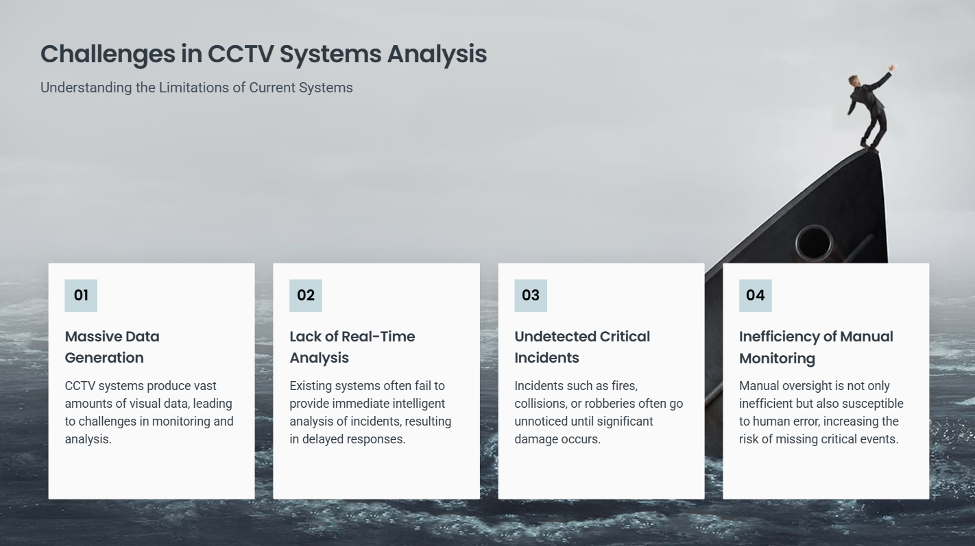

Slide 3
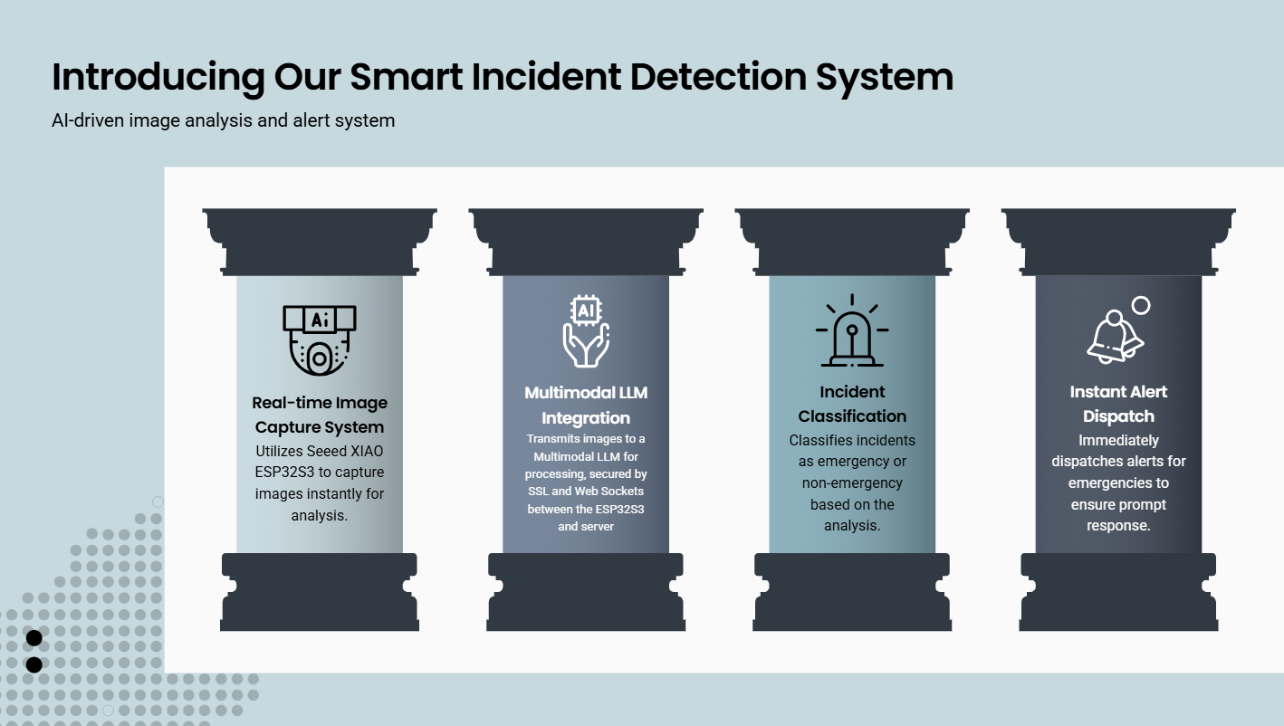

Slide 4

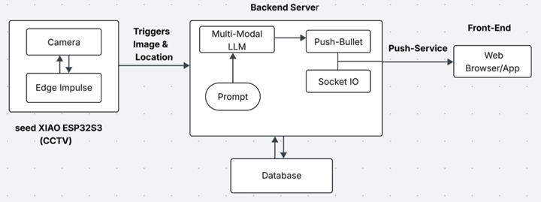

Slide 5
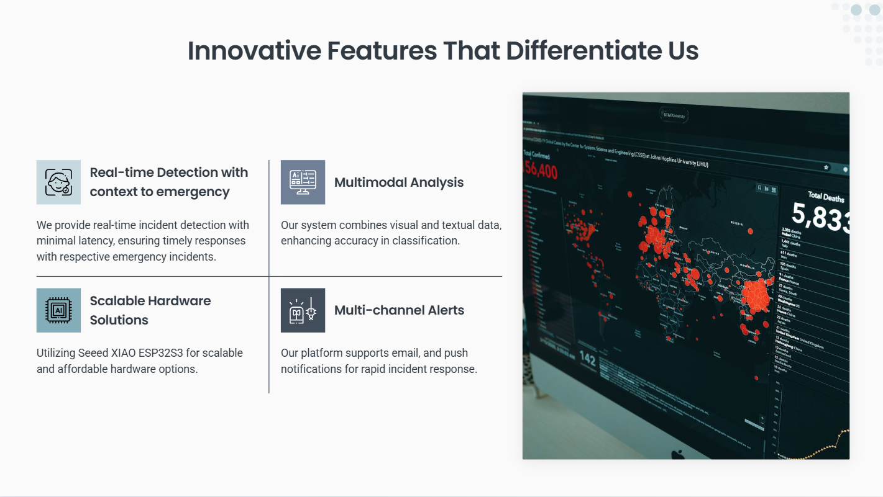

Slide 6
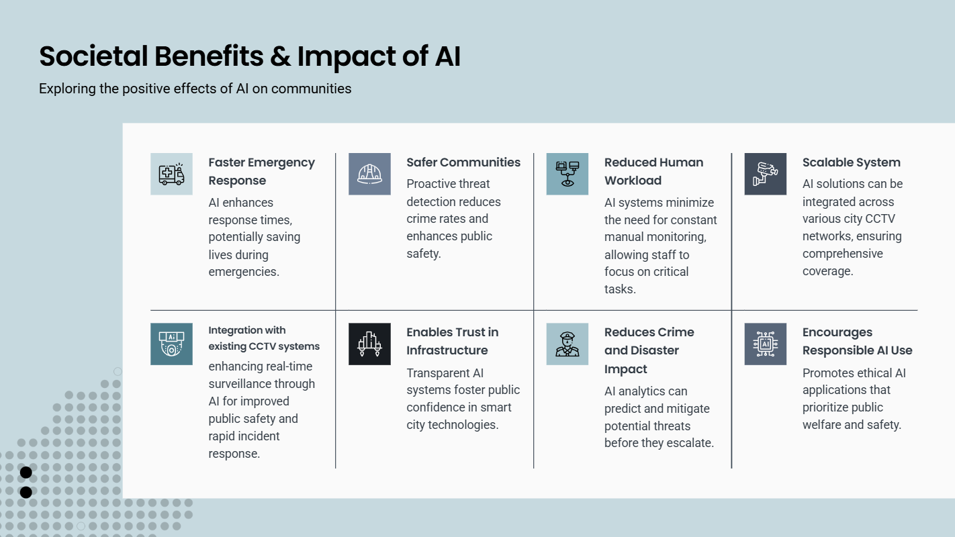

Slide 7
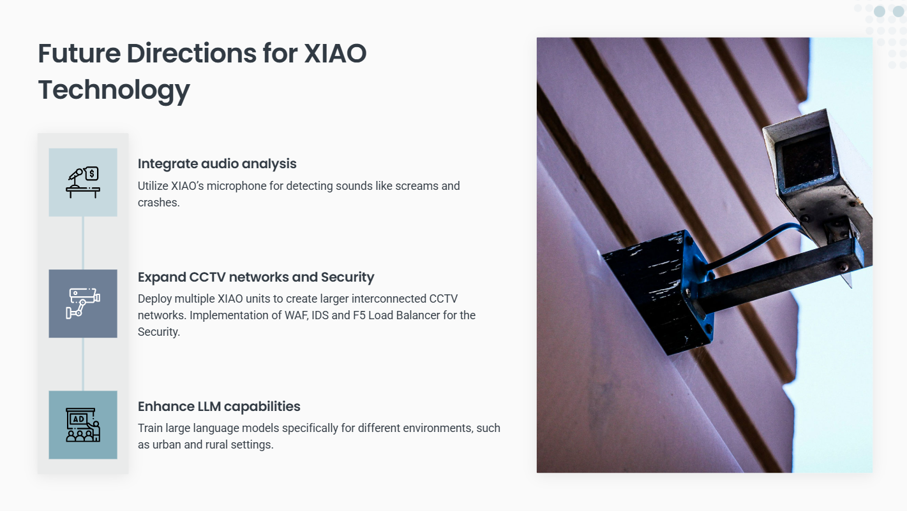

Slide 8


